Slide 1
Unit 3
Basic CSS

Slide 2
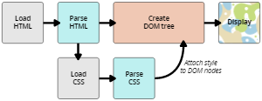
Intro to CSS
When a website loads it does things in a specific order:
First it parses the HTML (changes from code to computer logic)
Then it creates the DOM (talk about that more later)
And then applies the CSS to the finished DOM

Slide 3
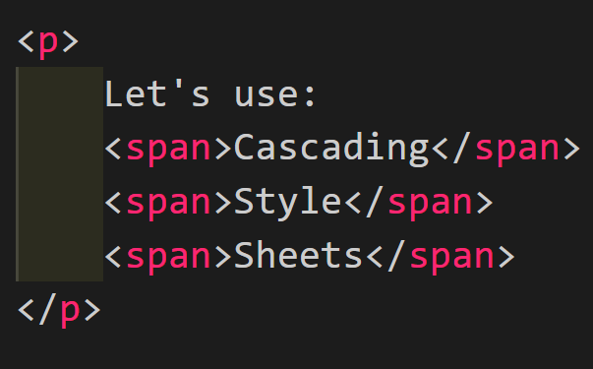
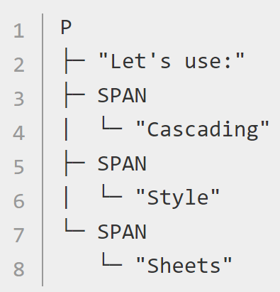
The DOM
The Document Object Model is kind of like a tree with branches that are all spread out

Slide 4
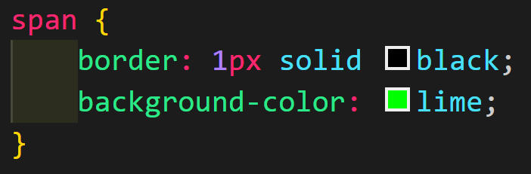
Applying CSS to the DOM
When creating the CSS selector it will look through the tree
then find the part of the tree that will matches the selector, changing the style sheet for that part

Slide 5
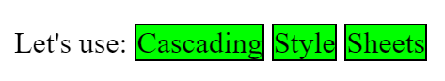

Slide 6
Finally Good News
Just like HTML, CSS will not break when you mess up your code.
Since your selector does not create new code, just modifies existing code, when you mess up and misspell something it will just skip that command since it does not match a branch in your DOM

Slide 7
Internal, External and Inline
You can add CSS in 3 ways:
External (most common way)
Creating a CSS file and linking it in the head
Internal
Using the <style> element
Inline
Using the style attribute

Slide 8
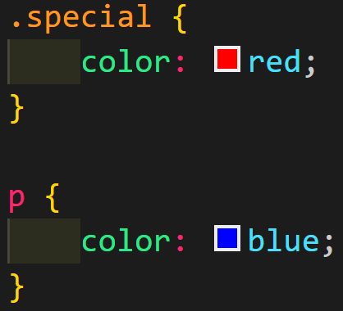
Specificity
Specificity refers to how specific you are when calling your selector
The more specific you are the better, less specific styles will be overwritten
.special is more specific than p so the text would be red

Slide 9
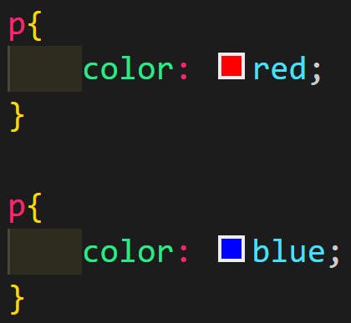
Order Matters
If you have 2 selectors with equal specificity the newest one (the one called on a later line number) will be chosen and overwrite the older one.
For example: the paragraph text would be blue in the example on the left

Slide 10
CSS Rulesets
The things that you put inside of the selector brackets are called properties and values. Put these all together and you get a ruleset
selector {
property: valueunits;
}
~~~~~~~~~~~~~~~~~~~~~~~~~~~~~~~~~~~~~~~~~~~~~~~~~~~~~~~~
footer {
margin-top: 10px;
}

Slide 11
Definitions
CSS selector
Chooses a DOM element
CSS property
Changes a part of it
CSS value
States how the property should change
CSS Declaration
When a property is paired with a value
CSS Declaration Block
When several properties are paired with several values

Slide 12
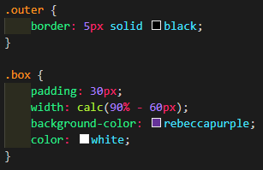
Functions
CSS usually just works in simple values and units but there is a way to do functions using calc

Slide 13
Functions
Spend some time on your own to look up different transforms in CSS and what they do
I will be calling on people to check on what you found

Slide 14
@rules
There are 2 @rules that you will need to know.
@ import
Loads a different CSS sheet into your CSS, a great way to load a reset stylesheet without having to link two in the HTML
@media
Shows which styles should be shown when a certain value is met

Slide 15
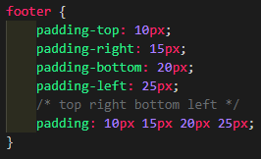
Shorthand Properties
There are some properties that can cover multiple
properties in 1 shorthand property
In the example on the
right, padding is compiled
clockwise starting at the
top

Slide 16
Comments
Just as you would expect, you write comments differently for CSS as well nothing is easy in coding
HTML <!-- -->
CSS /* */
JS //
Comments should be around when needed. Consider talking about what the rule set is doing

Slide 17
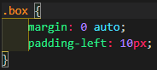
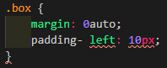
White Space
You can use all of the white space you want around the properties
inside of the properties and rulesets you need to be careful
Works Broken

Slide 18
Selectors
There are a lot of ways to say “that one there”

Slide 19
Selectors
The words at the start of CSS are called selectors. They tell the DOM where the different styles will be applied.
Normally your selectors can simply be the element that you want to change.
p{ }, h1{ }, a{ }, etc

Slide 20
Working with CSS
Let’s review a few easy examples. Please copy the code from GC and use the following properties to recreate the picture
font-family
color
border
font-weight
font-size
text-decoration

Slide 21
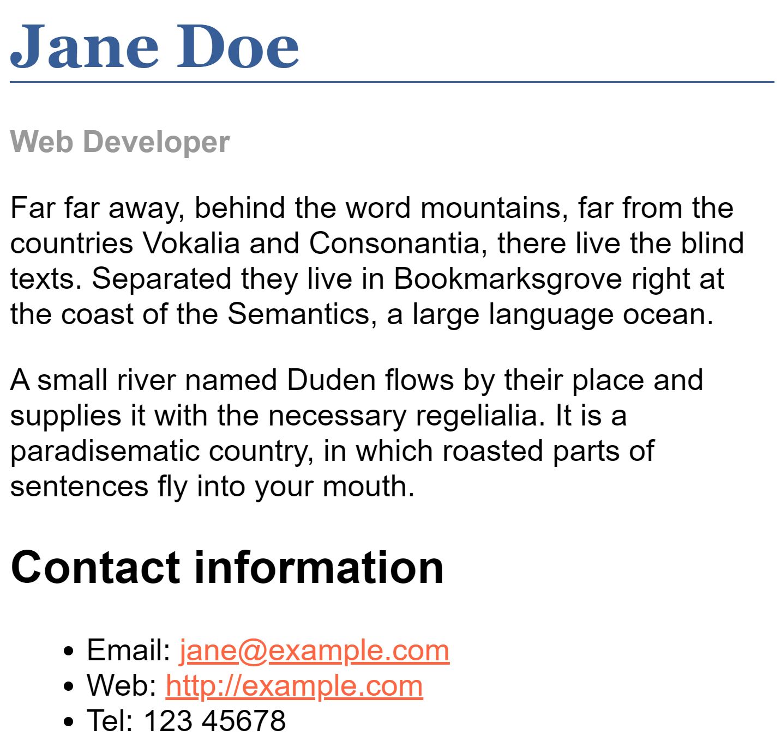
Make It Look Like...
body font-family: Arial, Helvetica, sans-serif;
h1 font-family: Georgia, Times New Roman, Times, serif;

Slide 22
Classes and IDs
You will want to choose specific elements from time to time. Maybe 1 <p> that holds a formula and you don’t want to affect every <p>
For this we use classes and IDs. You can give any element in the HTML a special name that you can reference

Slide 23
Classes
A class is a property in HTML that will mark a consistent theme in your code.
A class should be used if you need to change more than one thing
i.e. if you want to make columns in your work then the class=”col” should be used to define every column in the HTML
You call a class in CSS by using a “.” before the selector

Slide 24
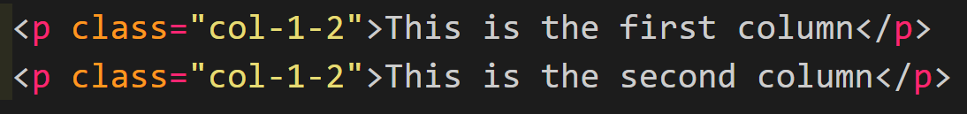
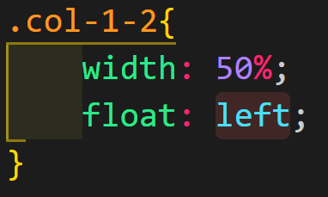
Classes

Slide 25
IDs
IDs are like classes in that they modify an element to make it easier to call out in the CSS
IDs should be used for a very specific change, Every ID should be unique or it should be a class.
i.e. id= “navicon” for just 1 picture that will show up
You call IDs by using “#” in the CSS

Slide 26
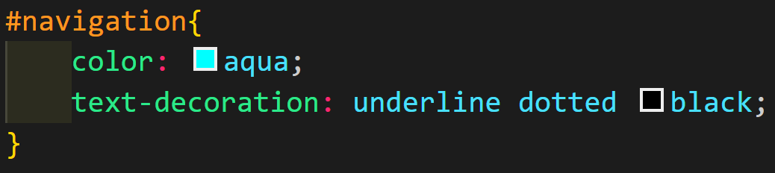
IDs

Slide 27
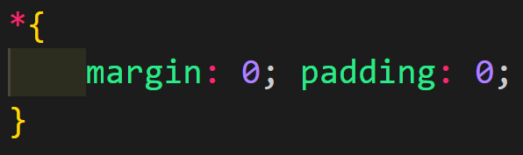
Universal Selector
If you want to select everything on the page you can use the asterisk “*”
If you want to remove the margins and padding from everything then use:
This has extremely low specificity and will be overwritten by everything

Slide 28
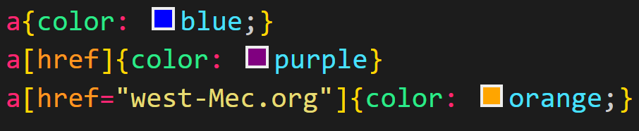
Attribute Selectors
You can use selectors that will affect an element based on what attributes are present or if the attribute has a specific value for that attribute

Slide 29
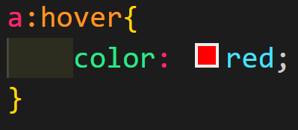
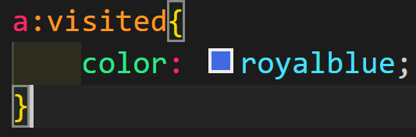
Pseudo-Classes and Pseudo Elements
Some elements have properties that we can’t see or they have events that can also affect the style
For instance if you hover over a link you can change the style or if the link has been visited before

Slide 30
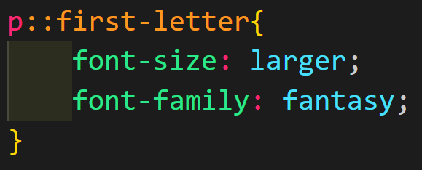
Pseudo-Classes and Pseudo Elements
Pseudo Elements can interact with the elements in an HTML, for instance if you want to change the first letter of every paragraph tag you can do that

Slide 31
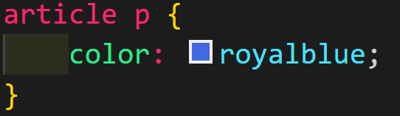
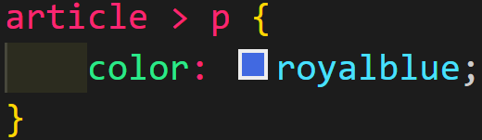
Combinators
If you want to effect any paragraphs in the article elements you use a space
If you want to only effect paragraphs that are DIRECT children of the article you use “>”

Slide 32
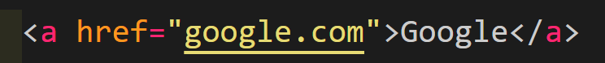
Practice Time part 1
Please Create a list of 5 links:
Name each link accordingly and use attribute selectors to change the colors. (example below of link and name)
Link Name Color
Google.com Google red
Wikipedia.com Wikipedia grey
W3schools.com W3Schools limegreen
Mdn.com MDN light blue
github.com github green

Slide 33
Practice Time part 2
Now that you have your links please:
Please make the first letter of all of the links be twice as large and use the fantasy font.
Use Pseudo-Elements to add “.com” to the end of every link’s name.
Use Pseudo-Classes to make sure the color of the links stay the same even when they are clicked.
Use Pseudo-Classes to remove the underline while you are hovering over them.

Slide 34
The Box Model
Page Layout

Slide 35
Add a
Add a page about about box-sizing: borderbox

Slide 36
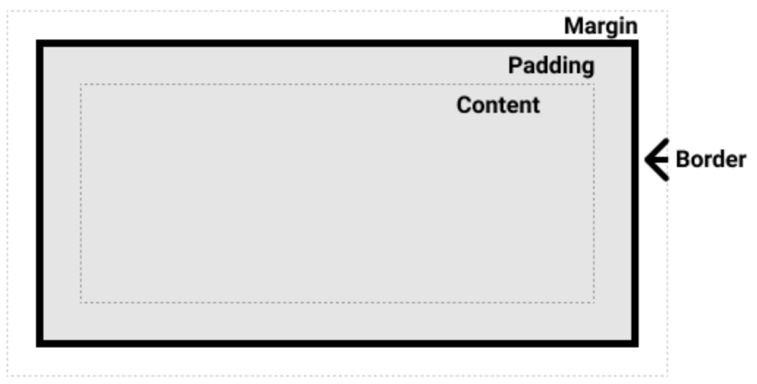
Every Element is a Box
Every box has 4 parts
Content where the writing goes
Padding around the content
Border around the padding
Margin around the border
You can see these parts if you use the dev tools with inspect

Slide 37
Block Boxes and Inline Boxes
If you define a box as a block if will have the following properties (this is the default display)
The box will <br> into a new line
Boxes will extend its width to fill the entire container that it is held
Width and height properties are respected
Padding, margins, and borders will cause other elements to be pushed away from the box

Slide 38
Block Boxes and Inline Boxes
When a box is defined as inline then it will have the following properties.
The box will not break onto a new line
The width and height properties will not apply
Vertical padding, margins, and borders will apply but will not cause other inline boxes to move away from the box
Horizontal ones will apply and will cause other inline boxes to move away from the box

Slide 39
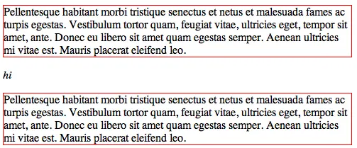
Display: block
Default value for most elements
Auto breaks the container elements

Slide 40
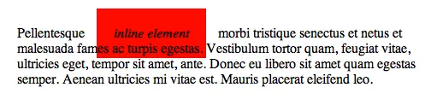
Display: inline
Does not break the container into a new line
Horizontal changes work
Vertical changes are ignored

Slide 41
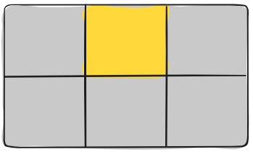
Display: grid
Grid works like how it sounds, it creates a grid pattern on the page and you can fill in the cells.
Block style by default with more format options

Slide 42
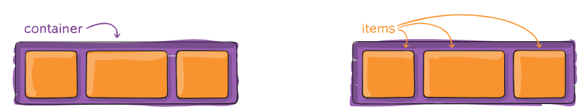
Display: flex
flexbox is one of the newest types of display that you can use. It is quickly becoming standard use for most sites
Works like block but with different formatting options

Slide 43
display: grid
The Parent Properties
Basic but always supported by all browsers and still very in depth

Slide 44
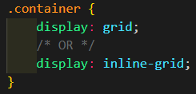
Display
display: grid
Gives you a block-level grid
display: inline-grid
Gives you an inline-level grid
Typically you want to stick with block-level grid but you can mess with either if you want to play around

Slide 45
Grid templates
grid-template-columns
Defines the columns of the grid with space-separated values
grid-template-rows
Defines the rows of the grid with space-separated values
The values represent each cells width and the spaces can be thought of as the dividing grid lines

Slide 46
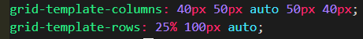
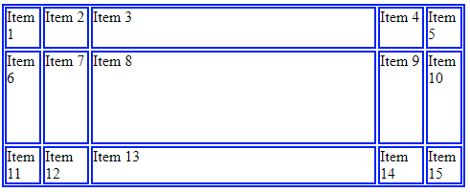
Grid Templates

Slide 47
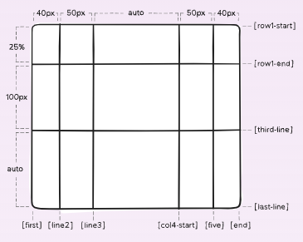
Grid Templates
You can name the columns if you like by adding [name] between the sizes but it is not required

Slide 48
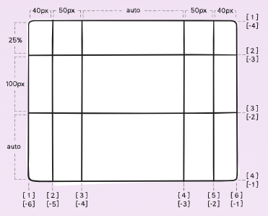
Grid Templates
If you don’t name them they will just be numbered instead.

Slide 49
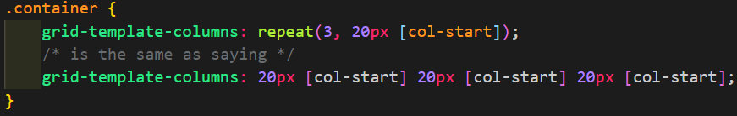
Grid Templates
There is a shortcut that we can use if you want to create several columns or rows with the same sizes.
repeat() function

Slide 50
MORE GRID TEMPLATES
You are able to seperate your grid cells in several ways:
Percents - 25%
Will fill the cell to be a certain percentage of the full container (will change with the screen)
Pixels - 100px
Creates a fixed sized box that won’t budge
Auto - auto
Fills the remaining space in the container
Fractions - 1fr
Fills the content based on a fraction of total fr’s declared

Slide 51
Grid Template - Fractions
Free space to be divided up by the fractions will be calculated AFTER all non-flexible items

Slide 52
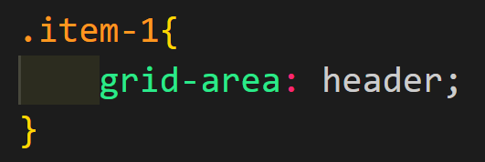
Grid Areas Step 1
You can create grid-areas with names and defined grid cells.
First name your areas using classes or elements

Slide 53
Grid Template Areas
You can divide out the cells of the grid to make areas
“name”
Represents a grid item
.
represents an empty cell
None
represents no grid area defined.

Slide 54
Grid Area Step 2
Once you have a name for your item you can then use it to create the grid layout
Everytime you say the name a new cell is reserved for that grid area

Slide 55
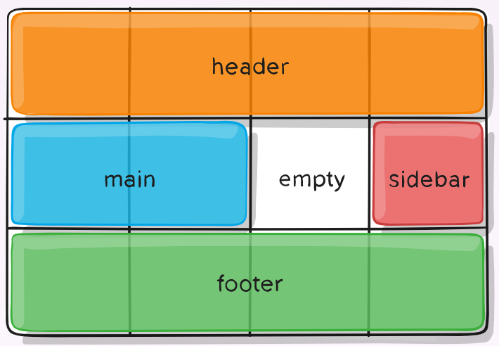
Grid Area Example
Let’s use grid areas to recreate this picture
Please change the backgrounds to match the colors

Slide 56
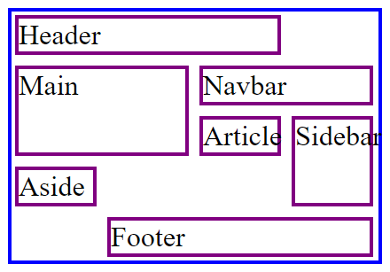
Grid Area Practice
Recreate this grid layout, you will need to add a little to the HTML and CSS
The blue border may extend to the right of the screen, that’s ok.

Slide 57
Let's practice with a real site
On the next slide I am going to work with you to divide the site into sections with you.
Please draw a rough sketch with me so that you can recreate the site with simple words
This is going to be a much harder project than the last example IF YOU DON’T FOLLOW ALONG YOU WILL BE LOST

Slide 58
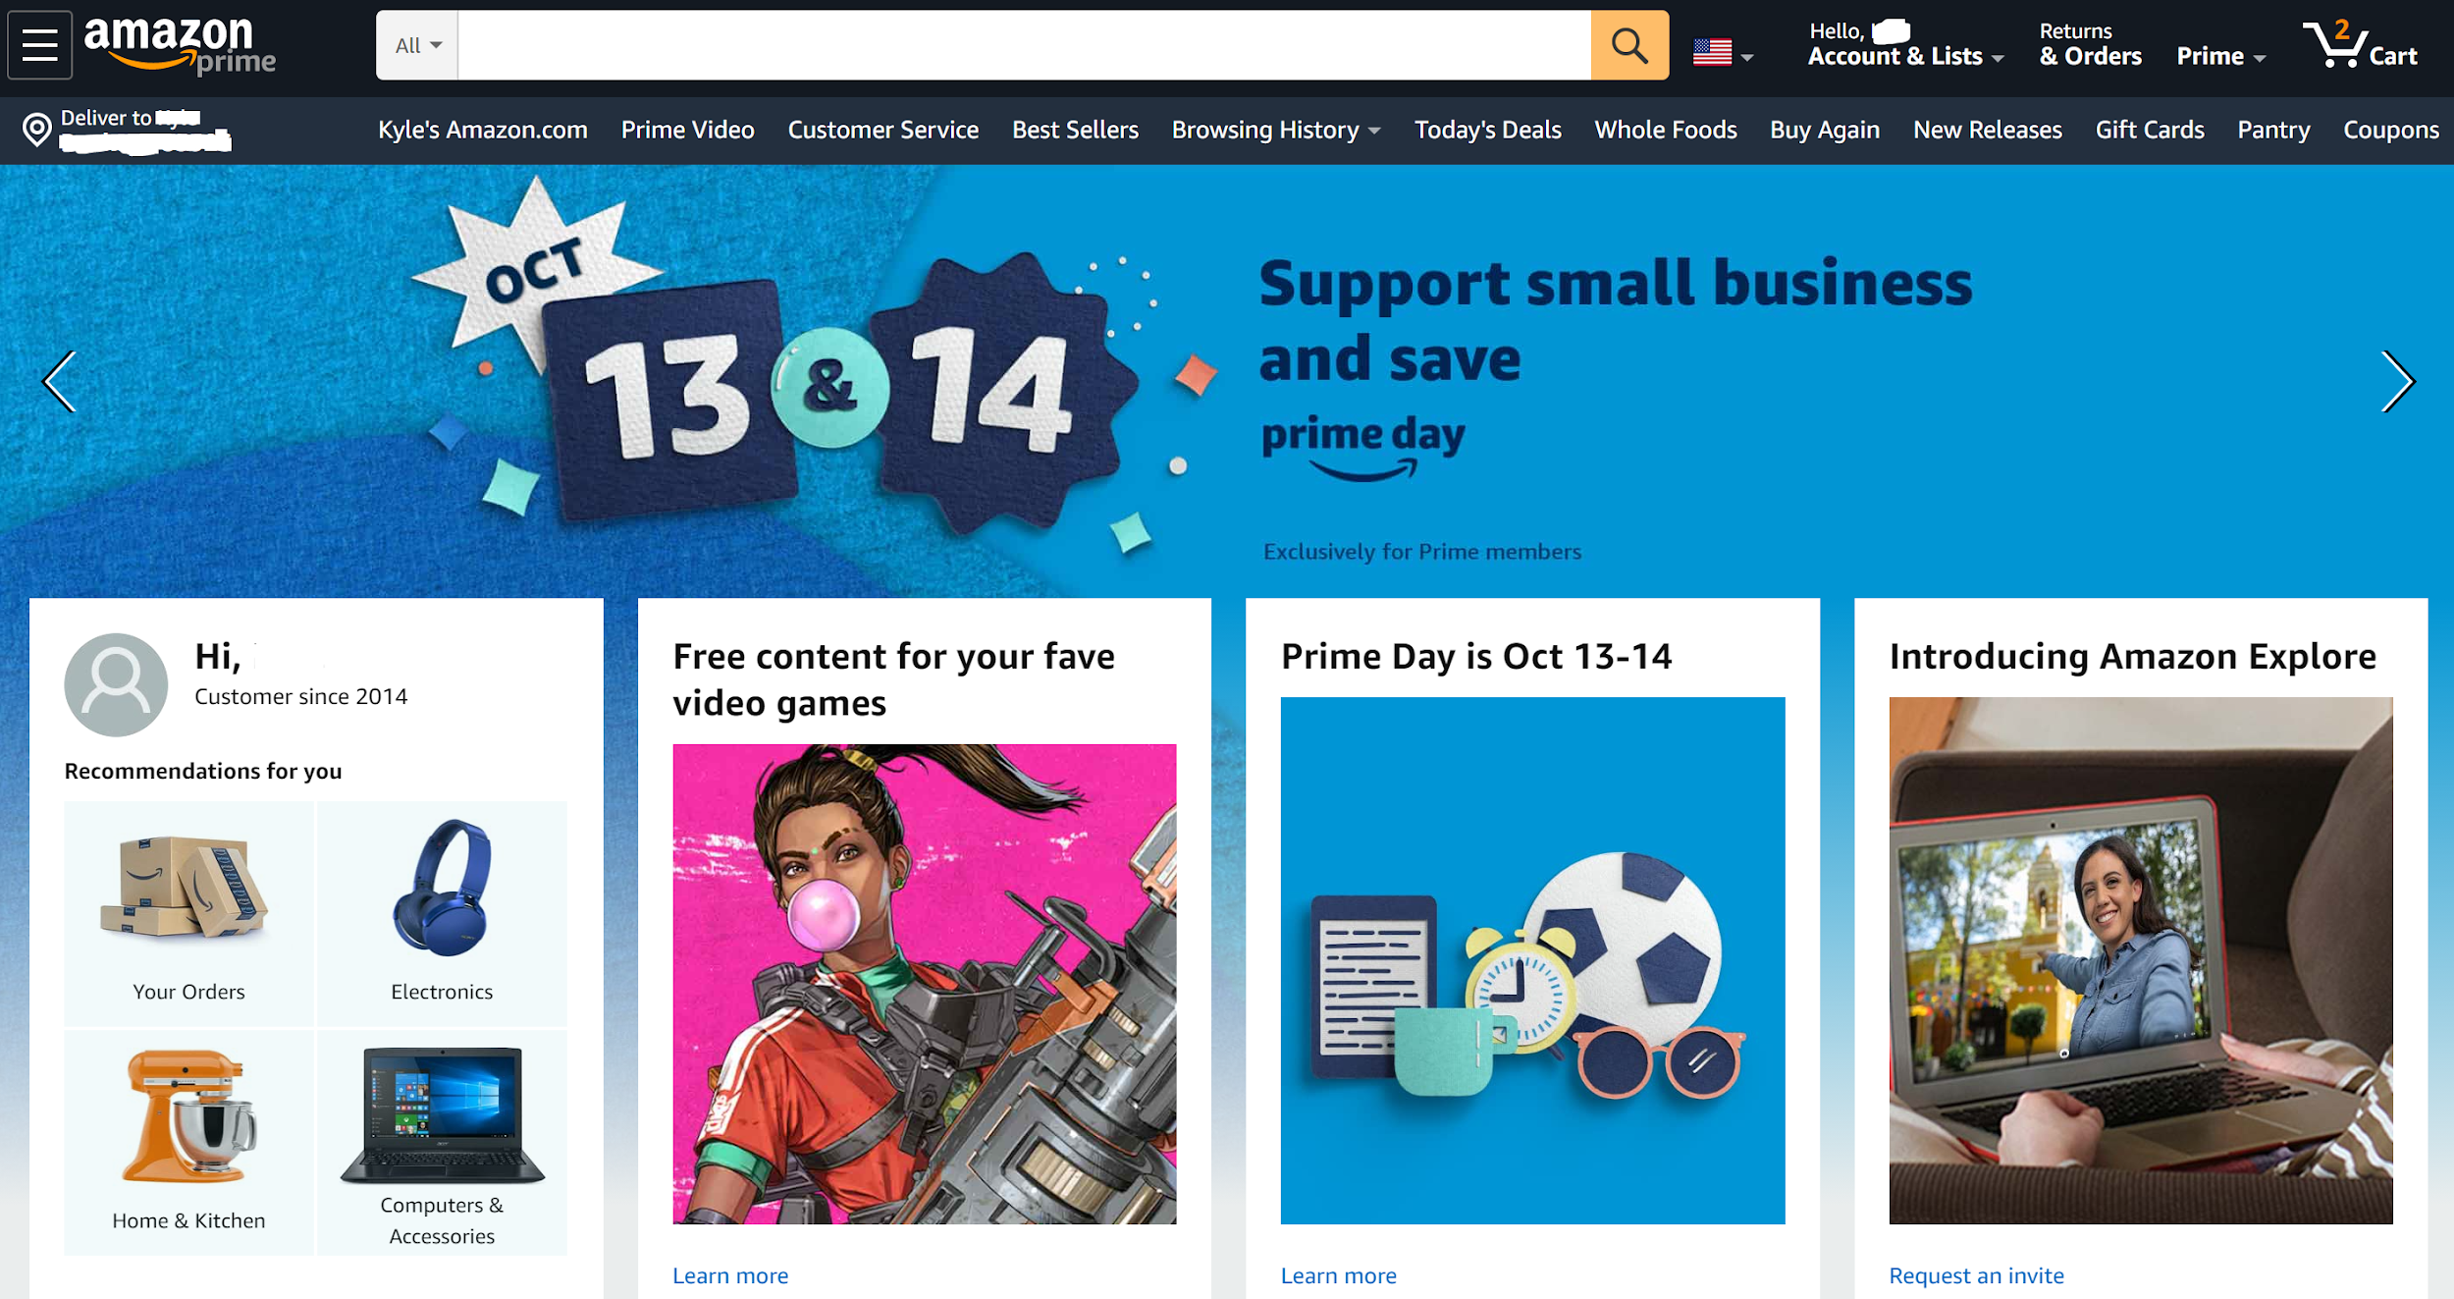

Slide 59


Slide 60
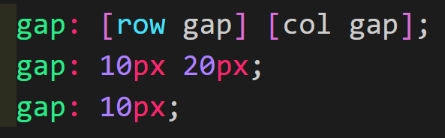
Grid Gap
This only creates spaces between the areas in the grid, it will not have a gap between the areas and the container
If you only say 1 it will change both

Slide 61
Justify-Items
There are 4 values for this
start
Aligns items to be flush with the starting edge of their cell
end
Aligns items to be flush with the end edge of their cell
Center
Aligns items in the center of their cell
Stretch
Fills the whole width of the cell

Slide 62
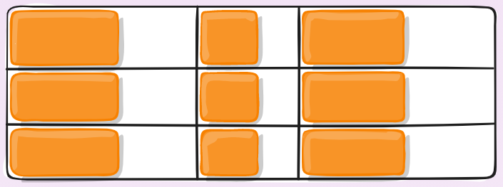
justify-items: start

Slide 63
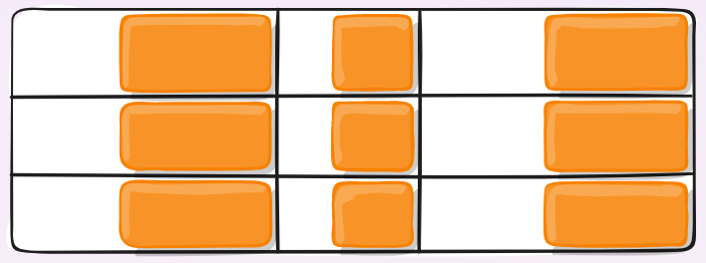
justify-items: end

Slide 64
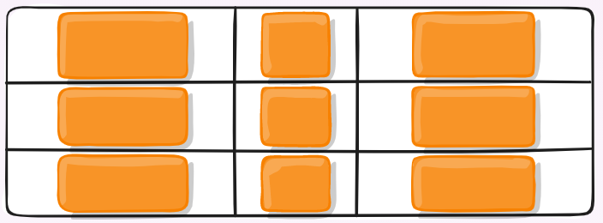
justify-items: center

Slide 65
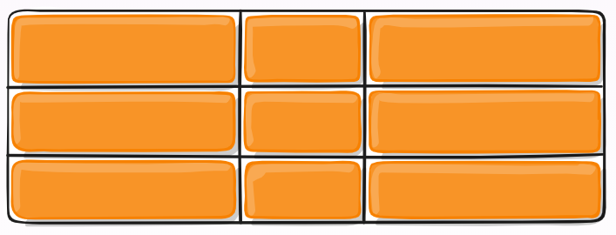
justify-items: stretch

Slide 66
align-items
Justify is left and right, align-items is up and down
It cas the same 4 values as justify and they basically same things, just top to bottom

Slide 67
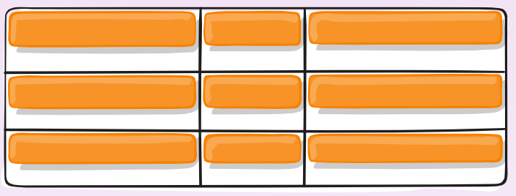
align-items: start

Slide 68
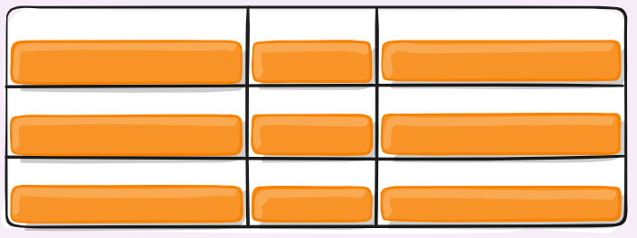
align-items: end

Slide 69
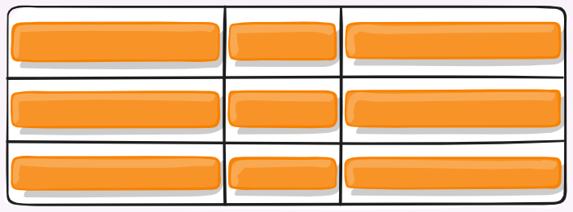
align-items: center

Slide 70
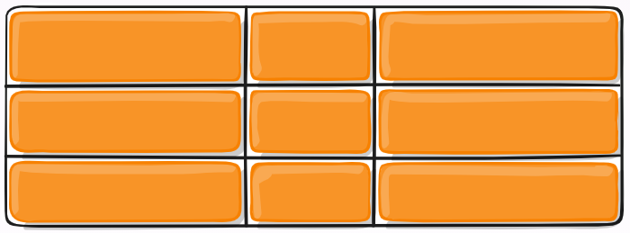
align-items: stretch

Slide 71
justify-content
Justify content also works similarly but affects the container instead of the grid cells it has 3 new values
Space-around
Splits the space remaining evenly around the grid items
Space-between
Splits the space remaining evenly between the grid items
Space-evenly
All space around the items will be the same size

Slide 72
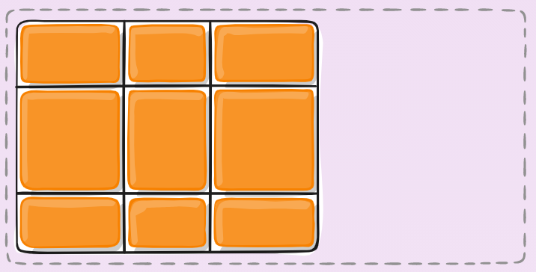
justify-content: start

Slide 73
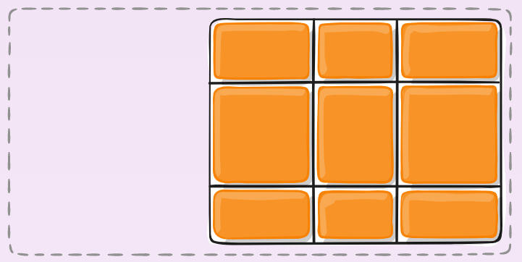
justify-content: end

Slide 74
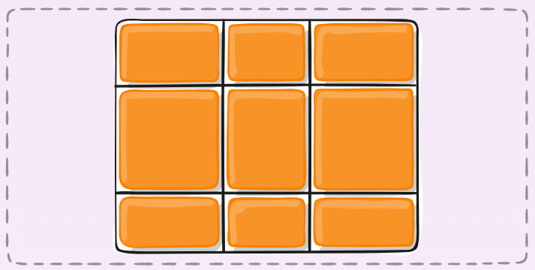
justify-content: center

Slide 75

justify-content: stretch

Slide 76

justify-content: space-around

Slide 77

justify-content: space-between

Slide 78

justify-content: space-evenly

Slide 79
align-content:
Sometimes there is extra space around the grid in the container which can happen when you use non-flexible units like px.
This will reposition the entire grid inside of the grid based on the value. They are all the same values as justify-content

Slide 80






align-content:
start
end
center
stretch
space-around
space-between

Slide 81

Grid Column/Rows
You can position your items based on the grid rows without using grid-template-areas
If you just use grid-column: and grid-row: stating the starting and ending lines.

Slide 82
Grid Area Example
Let’s use grid areas to recreate this picture
Please change the backgrounds to match the colors

Slide 83
Grid Columns/Rows Practice
Recreate this grid layout again, this time ONLY USING grid-columns and grid-rows
This grid is 4x5

Slide 84
grid-auto-columns/rows
If items are placed outside of out grid some messy stuff can happen
We can adjust for this by creating auto columns/rows
this will tell your code how to fill in the extra space that you didn’t plan for

Slide 85

grid-auto
This is an example how of how it will work normally, without the auto grid

Slide 86

grid-auto
Same thing, this time using
grid-auto-columns: 60px;

Slide 87
Wrapping it all together
You can use the shorthand of “grid:”
You can use:
grid-template-rows
grid-template-columns
grid-template-areas
grid-auto-rows
grid-auto-columns
grid-auto-flow
It doesn’t have to be in order

Slide 88


Example
Is the same as

Slide 89
Picture Grid Project
Please download the zip from google classroom that has all the images you will use for your project use them to complete the project sheet.

Slide 90
Flexbox
It’s a box but it’s Flexible

Slide 91

Container Properties
The following will be properties that you can apply to the container of the flexbox.
We call this the Flex Container

Slide 92
display: flex
Just like with grid, if you want to use the properties that are associated with a certain type of display, the first thing you need to do it is declare the display type.
There is also display: inline-flex but don’t use that one.

Slide 93
Grid vs. Flexbox
Grid has its focus on the cells and laying out the grid before hand so that it can be filled in.
Flexbox instead focuses on the items in the container, there aren’t cells in the container like there are in grid.
Items in the container and treated similarly to the cells but they have a lot more flexibility and are not locked into the grid cells

Slide 94


flex-direction
The first thing you need to decide when you use flex is which direction the overflowing will happen.
Row (default)
row-reverse
column
column-reverse

Slide 95
Flex-Direction - Practice time
Open up VSCode

Slide 96

flex-wrap
By default flex items will try to fit all on one line but you can change that as needed.
nowrap (default)
wrap
wrap-reverse

Slide 97
Flex Wrap - Practice time
VSCode time

Slide 98
justify-content
It is important to say which way the flex items should be aligned within the container along the main axis (horizontal for flex-direction: row or vertical for column)
These work very similarly to grid so I will just show the pictures

Slide 99






justify-content
flex-start
center
space-around
flex-end
space-between
space-evenly

Slide 100
align-items
This works similar to the the box model and positions the items vertically in the container
There is a new value called baseline, this will move every items so that the text in the items is aligned.

Slide 101





align-items
flex-start
center
stretch
flex-end
baseline

Slide 102
align-items
Vscode practice time

Slide 103
align-content
This aligns the flex container’s lines between the items.
This property doesn’t do anything if there are not multiple lines of items in the container

Slide 104






align-content
flex-start
center
space-between
flex-end
stretch
space-around

Slide 105

Item Properties
These are the properties that you add the flex items
These should be placed directly on the items that you want to affect

Slide 106



order
The order properties will allow you change the placement of your items inside of your container
This is a powerful tool if you want to reorder your items when the screen reaches a certain size

Slide 107
flex-basis
This defines the default size of an element before the remaining space is distributed.
It can be any length (20%, 5rem, etc…)
The auto keyword means that the item will fill in the remaining space if possible

Slide 108

flex-basis
If set to 0 the space around the content is not factored in. If set to auto, the extra space is distributed based on it’s flex-grow value

Slide 109


flex-grow
This defines the ability for a flex item to grow if necessary.
If all items are set to 1 then they will try to divide the remaining space equally.
If one of them is set to 2 then that item will take up twice as much of the remaining space if possible.

Slide 110
flex-grow
Practice time again

Slide 111

flex-shrink
This defines the ability for a flex item to shrink if necessary
Negative values are invalid

Slide 112

align-self
This allows the default alignment (the one specified by align-items) to be overridden for individual flex-items.
These have the same 6 keywords as the align-items property

Slide 113
Logging Menu Project
This project will use both Grid and Flex to their fullest
We are not going to focus on responsive design for this one
Please pull up the files from Google Classroom

Slide 114
Floats
IMPORTANT! Not a huge topic but you need to know this!

Slide 115
Floats
The float property was introduced to allow web developers to implement simple layouts involving an image floating inside a column of text.
Floats have been used to create entire website layouts featuring multiple columns of information floated so they sit alongside one another

Slide 116

float:
The float property is the way that you can move your items around the page and have the rest of the content move around them.
None - default, element does not float
Left - element floats to the left of its container
Right - element floats to the right of its container

Slide 117
Float examples
VSCode time!

Slide 118

Clearing floats
When you use floats the element will move other elements out of the way and they will wrap around the floated object
If you want to stop the next element from moving up and filling in the space you use the clear property

Slide 119
Clearing Floats
You can clear space around the float items to get rid of content that you don’t want near it.
Clear: left;
Clears items floated to the left
clear: right;
Clears items floated to the right
clear: both;
Clear any floated items, left or right

Slide 120
Clearing the Surroundings
If you want to clear a smaller area to use as a background then you need to create a wrapper class.
VScode practice time

Slide 121


Container Collapse
This is a common issue with floats
Since the square has float: left; it is taken out of the .wrapper container which causes the blue square to “collapse”
VS

Slide 122

The clearfix Hack
This is a common practice and maybe one day there will a better way to fix it, so don’t feel bad about hacking your code.
Type the following into any container that has collapsed and it will be fixed

Slide 123

Overflow property
You can also just add the overflow: auto property to the container and solve it that way but people won’t be as impressed if you do it this way

Slide 124
Positioning
Moving items around the screen independently

Slide 125
Positioning
Positioning allows you to place elements and objects where you want and override the setting the default style sheet gives.
Just use the position property

Slide 126
position: static
This is the default setting and will place the element in order with the rest of web page.
There is no reason to use this since it won’t move anything and then you can just leave it blank if you want this positioning

Slide 127
position: relative
This will allow you to move your element/object around the page relative to where it should be placed.
Top - will push it on the top and move it down
Left - will push it on the left and move it right
Bottom - will push it on the bottom and move it up
Right - will push it on the right and move it left

Slide 128
position: absolute
This removed the element from the rest of the document and the flow of the elements
Instead of being positions within the rest of the document and the flow it will instead be move to the top left of the page no matter what is in the way

Slide 129
z-index
Layering your content on top of each other is not always easy when you are dealing with position.
To make sure the correct element is showing on top layer we can use z-index
The higher the number the better

Slide 130
position: fixed
This works similar to the absolute positioning, it will move the element to the top left of the page and remove it from the list of elements in the document.
The difference here is that the fixed will moved with the screen when you when scroll.

Slide 131
position: sticky
The value of sticky is a mix between fixed and relative.
It will be placed inline with the rest of the elements like relative positioning.
The difference is when you scroll past it, the element will be “stuck” to the top of the screen and scroll down with you

Slide 132
Quick Point:
SVG Backgrounds
This won’t take long

Slide 133
Introduction to SVG
SVG stands for Scalable Vector Graphics
These are used to create icon, backgrounds, images, and sometimes whole logos.
The benefit of SVG over PNG or JPG is the fact that they do not use pixels, they will retain the same level of detail no matter how much you zoom in or out.
They aren’t too hard to make we why do that when there are a ton of free sites that do it better!

Slide 134
Sites
Please visit the sites that I posted on Google Classroom and take a 5 minutes to explore and design a background that you like.
https://www.svgbackgrounds.com/
https://www.visiwig.com/icons/

